Slide 1
Classical and hybrid quantum-classical
ML analysis of bias in loan default prediction
Tan Dai Ngo, Da Zhang, Yuanming Wang, Joyce van de Vegte , Naomi Phan, Jeremy Perkins
Notes:
We should NOT read the title :)!

Slide 2
Plan
Intro motivation/basic pipeline/SMOTE Dai 2.5
XGBoost Models - suitability/hyperparameters/results Adam 2
NN Models - suitability/hyperparameters/results Yuanming 2
Feature engineering (QELM) Joyce 2
Fairlearn Naomi 2
Per feature heatmaps (results for Fairlearn and QELM) Jeremy 2

Slide 3
Bias in loan default modelling
What is the point of our work/ our motivation
Why bias for a loan default model is important - banks use loan default to inform loan approval models
FNR is what the bank cares about, FPR is what the client cares about
Dataset: Loan default https://www.kaggle.com/datasets/sumit12100012/loan-approval-classification/data
Features: 5 categorical and 7 numerical demographic and financial features
Notes:
Don’t need to read out all the features.

Slide 4
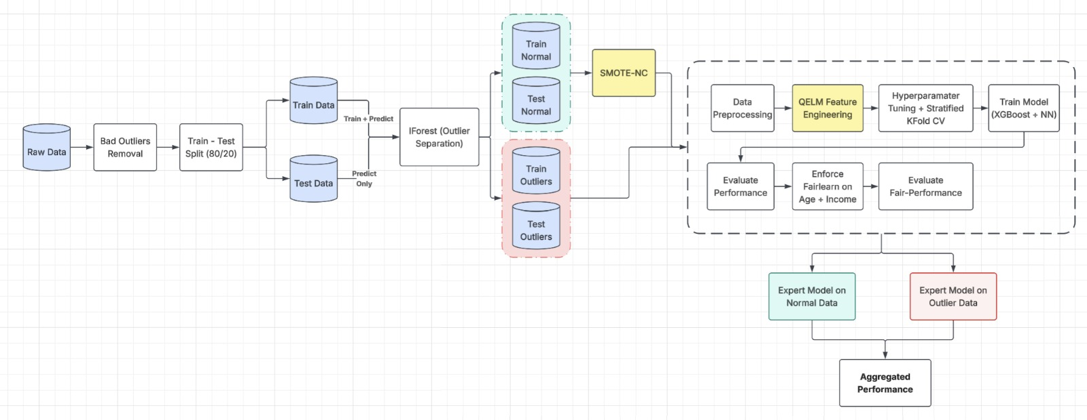
Key pipeline elements
Notes:
E.g. > 144 years old. What is isolation forest. iForest trained on training data only. Remind what is SMOTE. Also, why it was important to split off test before iForest and SMOTE.

Slide 5
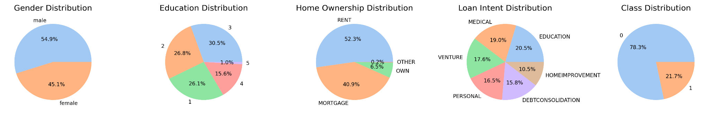
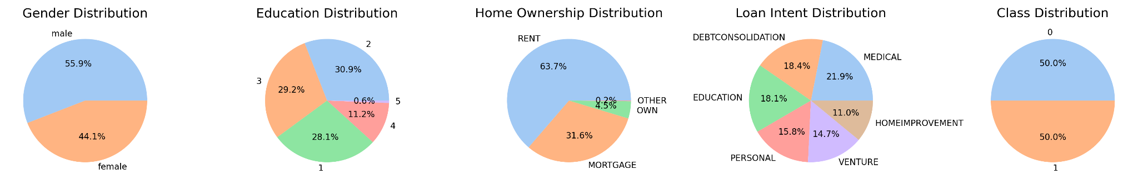
Effect of SMOTE on categorical features
Before SMOTE
After SMOTE
No samples with previous defaults have loan default so “previous loan defaults on file” feature was removed to avoid bias.
Notes:
Very brief on these two slides. Note that class distribution for targets is now 50/50, but some shifting in other distributions…

Slide 6
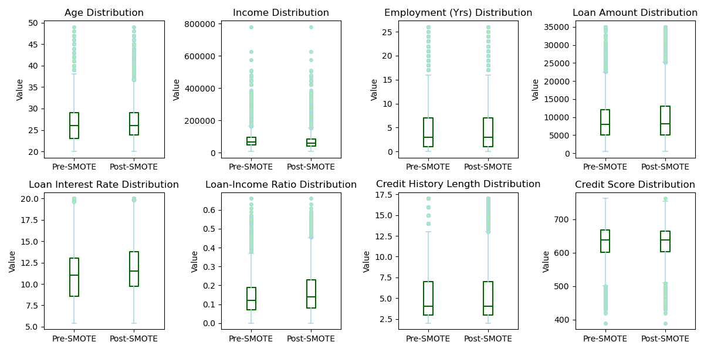
Effect of SMOTE on numerical features
Notes:
…more noticeable for numerical features.

Slide 7
Models: XGBoost and Neural Network
What is XGBoost
Why is it a good choice for this data
What hyperparameters can be tuned
Neural Networks
Why is it a good choice for this data
What hyper parameters can be tuned
What scaling/encoding needed for each type of model

Slide 8
Model results
What effect did SMOTE have? What do we want to point out?
Comment on differences between XGBoost and NN
bar chart
Model | Accuracy | FPR | FNR
Baseline XGBoost | 0.9143 | 0.0224 | 0.3070
Weighted XGBoost | 0.9080 | 0.0513 | 0.2345
SMOTE XGBoost | 0.9150 | 0.0283 | 0.2835
Baseline NN | 0.8940 | 0.0291 | 0.3750
SMOTE NN | 0.8419 | 0.1312 | 0.2525
Notes:
Tododo: turn the table into bar chart

Slide 9
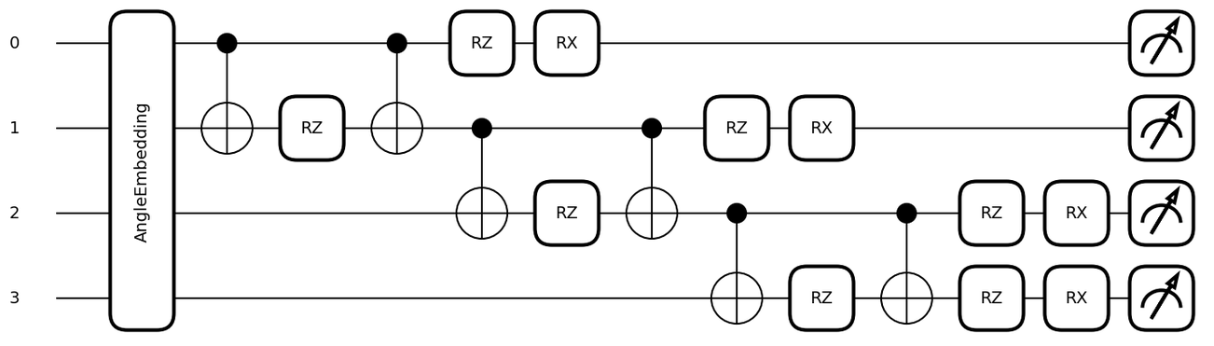
Quantum feature engineering
Each row is one qubit. Actual circuit has 12 qubits, one for each feature in dataset.
Features are encoded as angles.
For 12 qubits, quantum state exists in 2¹² = 4096 dimensions.
Observables create 78 quantum features.
Notes:
We experimented with several feature engineering methods, going to talk about just one. Just show this circuit, not both. Why might QELM be useful? Improve separability? Sensitive pattern detection (bias detection?). One layer is shown. Layers can be chained together for more expressivity.

Slide 10

One-slide quantum primer
Basis states for 1 qubit: |0⟩ and |1⟩
3-qubit quantum state in superposition
When measured, a quantum state collapses to classical bits.
Probability of measuring 000 is 0.7 and probability of measuring 110 is 0.3.
Observable detects patterns for each qubit and interactions between qubits:
Probabilities of basis states determine expected value over many samples.

Slide 11
Fairlearn-constrained debiasing
Fairlearn is an open-source project to help data scientists improve fairness of AI systems. https://fairlearn.org/
What capabilities does it offer?
How did we use it?
Comment on differences due to Fairlearn
Comment on differences due to QELM
Notes:
We did not know about this at the start

Slide 12
Fairlearn model results
Model | Accuracy | FPR | FNR
Baseline XGBoost | 0.9143 | 0.0224 | 0.3070
Fairlearn XGBoost | 0.9060 | 0.0130 | 0.3775
QELM Fairlearn XGBoost | 0.9039 | 0.0174 | 0.3715
SMOTE XGBoost | 0.9150 | 0.0283 | 0.2835
SMOTE Fairlearn XGBoost | 0.9133 | 0.0180 | 0.3270
Baseline NN | 0.8940 | 0.0291 | 0.3750
Fairlearn NN | 0.8705 | 0.0191 | 0.5155
QELM Fairlearn NN | 0.8608 | 0.0467 | 0.4630
SMOTE NN | 0.8419 | 0.1312 | 0.2525
SMOTE Fairlearn NN | 0.8488 | 0.0957 | 0.3455
Note that these are overall metrics

Slide 13
Per-feature deep dive
Explain FPR and FNR disparity heatmaps to compare bias before and after

Slide 15
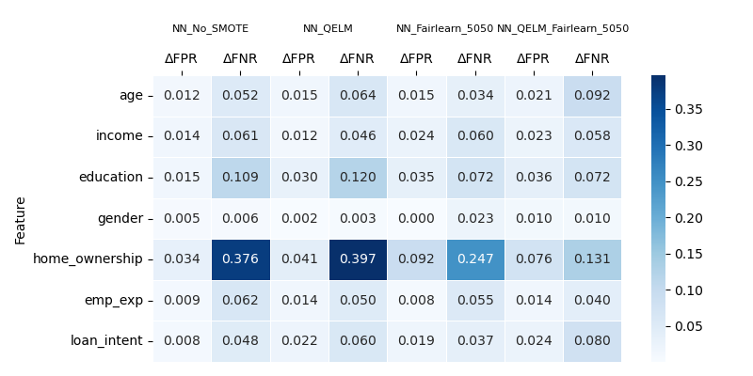
FPR/FNR disparity heatmap: No SMOTE Fairlearn (NN)
increasing weight on FPR disparity
increasing weight on FNR disparity
By weighting FPR disparity or FNR disparity more heavily through cost matrix, Fairlearn constraints can reduce bias on designated features in neural network.

Slide 16
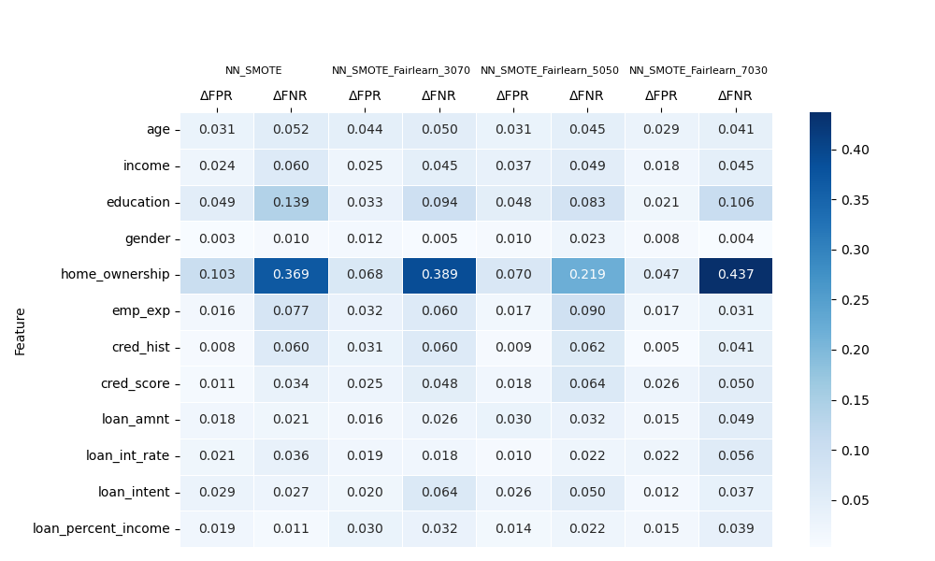
FPR/FNR disparity heatmap: SMOTE Fairlearn (NN)
increasing weight on FPR disparity
increasing weight on FNR disparity
Effects of Fairlearn constraints are reduced when SMOTE is applied to training data. SMOTE dilutes sensitivity to decision boundaries.
Satisfying constraints on synthetic data does not translate well to test set.

Slide 17
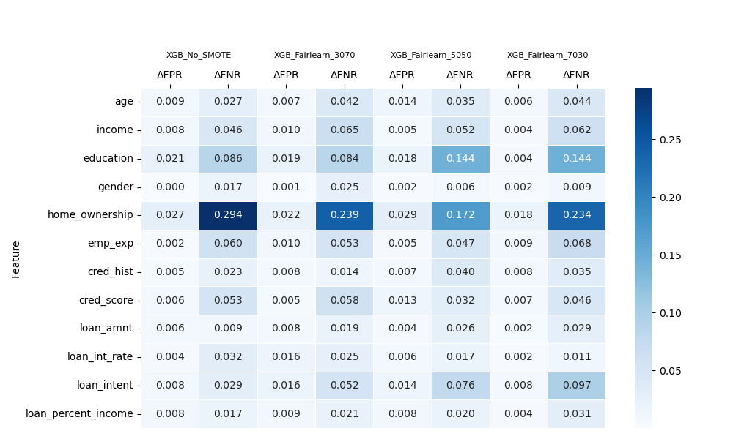
FPR/FNR disparity heatmap: No SMOTE Fairlearn (XGBoost)
increasing weight on FPR disparity
increasing weight on FNR disparity
Fairlearn does not behave predictably for XGBoost models.
Shifts due to Fairlearn constraints may cause variance in tree structure leading to complex optimization surface.

Slide 18
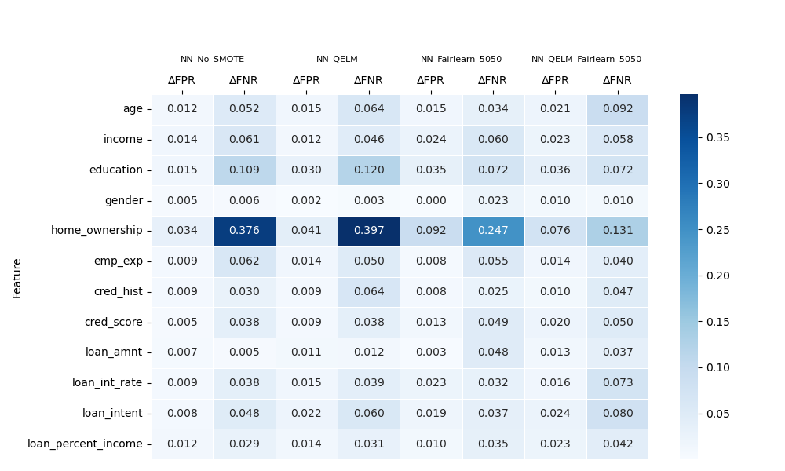
FPR/FNR disparity heatmap: QELM Fairlearn 50/50 (NN)
QELM feature engineering combined with Fairlearn produces a lower bias model overall, though not for constrained features and in an inexplicable manner.

Slide 19

Questions?

Slide 20
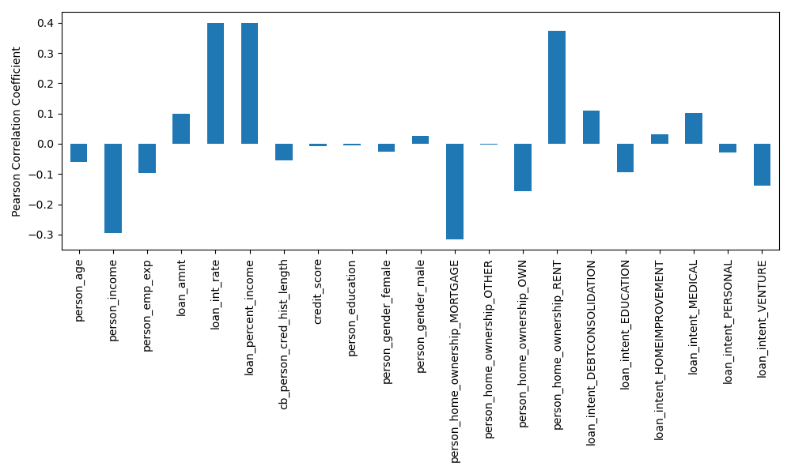
Correlation of features with target

Slide 21
All models
Model | Accuracy | F1-score | Precision | Recall | TPR | TNR | FPR | FNR
Baseline XGBoost | 0.9143 | 0.7824 | 0.8983 | 0.6930 | 0.6930 | 0.9776 | 0.0224 | 0.3070
Fairlearn XGBoost | 0.9060 | 0.7464 | 0.9319 | 0.6225 | 0.6225 | 0.9870 | 0.0130 | 0.3775
QELM Fairlearn XGBoost | 0.9039 | 0.7440 | 0.9115 | 0.6285 | 0.6285 | 0.9826 | 0.0174 | 0.3715
Weighted XGBoost | 0.9080 | 0.7871 | 0.8101 | 0.7655 | 0.7655 | 0.9487 | 0.0513 | 0.2345
SMOTE XGBoost | 0.9150 | 0.7893 | 0.8786 | 0.7165 | 0.7165 | 0.9717 | 0.0283 | 0.2835
SMOTE Fairlearn XGBoost | 0.9133 | 0.7753 | 0.9144 | 0.6730 | 0.6730 | 0.9820 | 0.0180 | 0.3270
Baseline NN | 0.8940 | 0.7238 | 0.8597 | 0.6250 | 0.6250 | 0.9709 | 0.0291 | 0.3750
Fairlearn NN | 0.8705 | 0.6246 | 0.8785 | 0.4845 | 0.4845 | 0.9809 | 0.0191 | 0.5155
QELM Fairlearn NN | 0.8608 | 0.6316 | 0.7666 | 0.5370 | 0.5370 | 0.9533 | 0.0467 | 0.4630
SMOTE NN | 0.8419 | 0.6775 | 0.6196 | 0.7475 | 0.7475 | 0.8688 | 0.1312 | 0.2525
SMOTE Fairlearn NN | 0.8488 | 0.6580 | 0.6614 | 0.6545 | 0.6545 | 0.9043 | 0.0957 | 0.3455

Slide 22
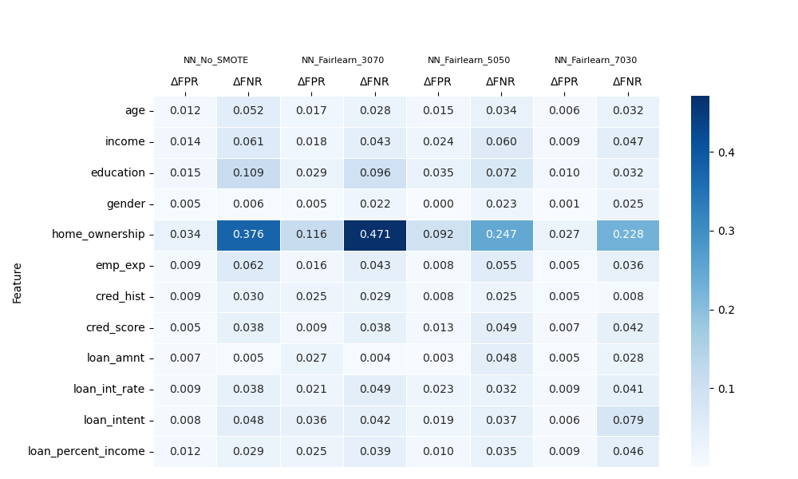
FPR/FNR disparity heatmaps: No SMOTE Fairlearn (NN)
increasing weight on FPR disparity
increasing weight on FNR disparity
By weighting FPR disparity or FNR disparity more heavily through cost matrix, Fairlearn constraints can reduce bias on designated features in neural network.

Slide 23
FPR/FNR disparity heatmaps: SMOTE Fairlearn (NN)
increasing weight on FPR disparity
increasing weight on FNR disparity
Effects of Fairlearn constraints are reduced when SMOTE is applied to training data. SMOTE dilutes sensitivity to decision boundaries.
Satisfying constraints on synthetic data does not translate well to test set.

Slide 24
FPR/FNR disparity heatmaps: No SMOTE Fairlearn (XGBoost)
increasing weight on FPR disparity
increasing weight on FNR disparity
Fairlearn does not behave predictably for XGBoost models.
Shifts due to Fairlearn constraints may cause variance in tree structure leading to complex optimization surface.

Slide 25
FPR/FNR disparity heatmaps: QELM Fairlearn 50/50 (NN)
QELM feature engineering combined with Fairlearn produces a lower bias model overall, though not for constrained features and in an inexplicable manner.

Slide 26
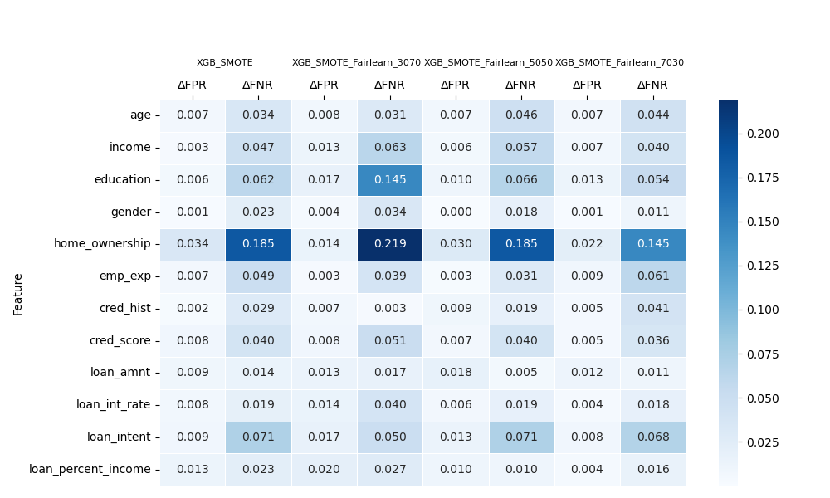
FPR/FNR disparity heatmaps: SMOTE Fairlearn (XGBoost)

Slide 27
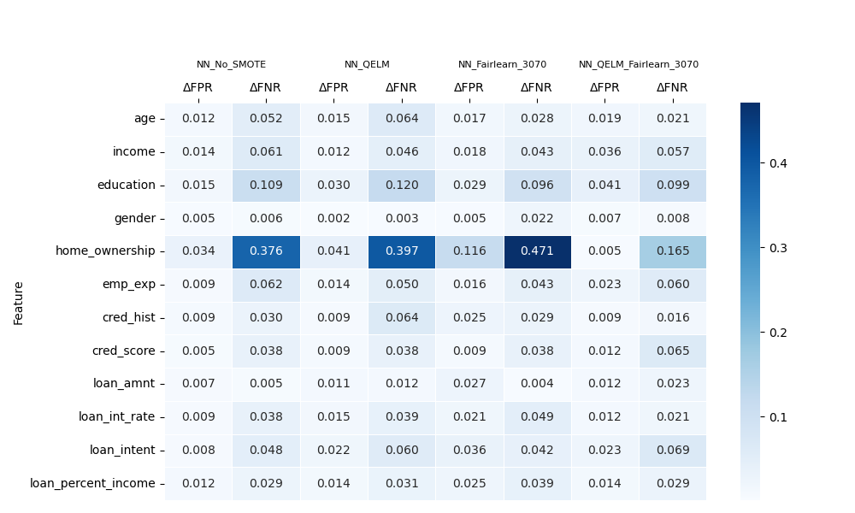
FPR/FNR disparity heatmaps: QELM 30/70 (NN)

Slide 28
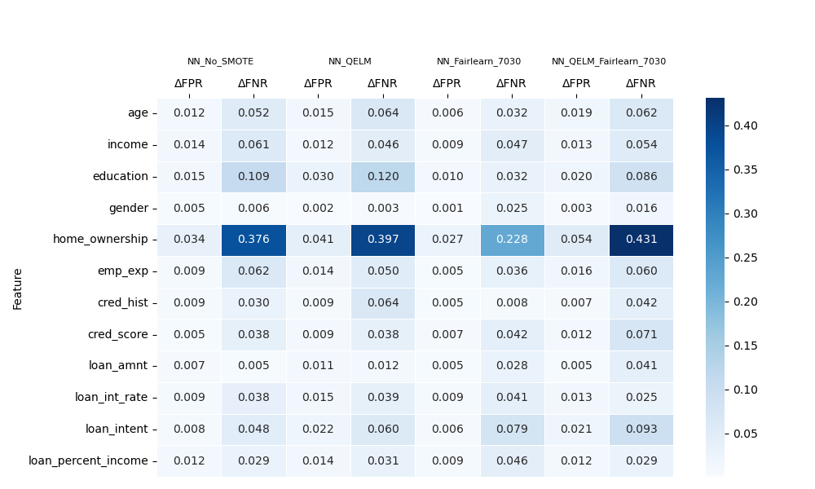
FPR/FNR disparity heatmaps: QELM 70/30 (NN)

Slide 29
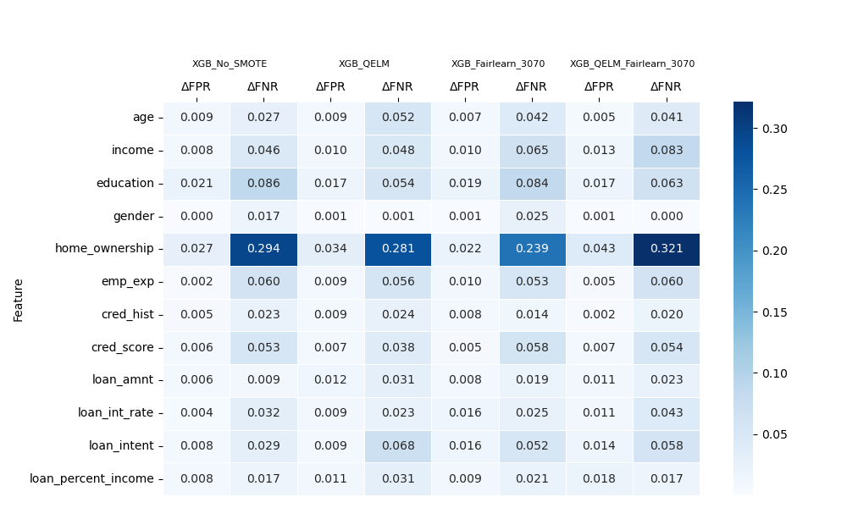
FPR/FNR disparity heatmaps: QELM 30/70 (XGBoost)

Slide 30
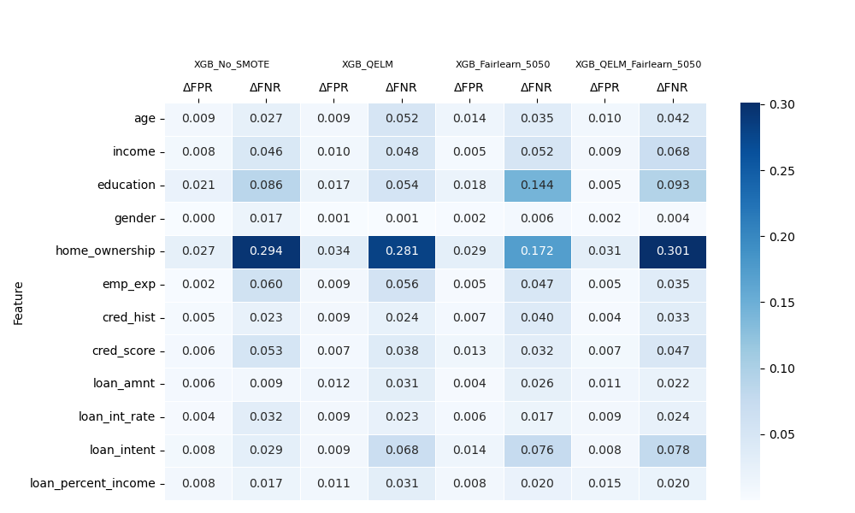
FPR/FNR disparity heatmaps: QELM 50/50 (XGBoost)

Slide 31
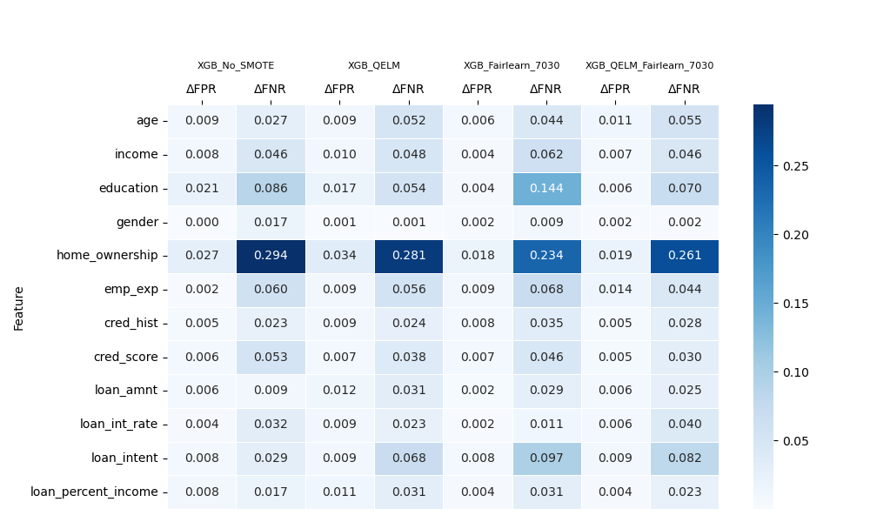
FPR/FNR disparity heatmaps: QELM 70/30 (XGBoost)

